Slide 1
Audio coding
B C Dhara
Department of Information Technology
Jadavpur University

Slide 2
Digital representation of audio
Sound is a form of energy that transmitted through a medium
  There is a catcher (like microphone) which converts the sound into analog signal
Digitizing an analog audio signal requires sampling and quantization
  The process of conversion to digital sound is known as pulse code modulation (PCM)
B C Dhara, Dept. of IT, JU

Slide 3
Digital representation of audio (contd ...)
In addition to sampling rate and quantization, another characteristic commonly used to describe audio signals is the number of channels,
  One channel (mono),
  two channel (stereo), or
  multichannel (surround-sound)
B C Dhara, Dept. of IT, JU

Slide 4
Introduction
The storage requirements of sound are smaller than those of images and movies, but bigger than those of text
Audio compression can be
  Lossy
  Lossless
Two important features of audio compression are
  It can be lossy
  It requires fast decoding
B C Dhara, Dept. of IT, JU

Slide 5
Surround Sound
Surround sound aims to create a three-dimensional sound experience
Surround sound usage is standard in movie theatres,
  allow the audience to hear sounds coming from all around them
True surround sound formats rely on multiple dedicated speakers that literally and physically surround the audience
B C Dhara, Dept. of IT, JU

Slide 6
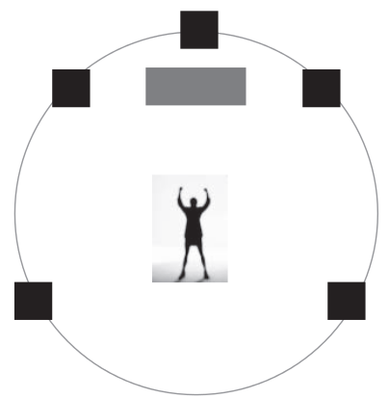
Surround Sound (contd …)
The commonly accepted version is 5.1 surround sound, which consists of six speakers
  One center speaker carries most of the dialog and five surrounding speakers
B C Dhara, Dept. of IT, JU

Slide 7
Spatial audio
Spatial audio, similar in intent to create a surround sound like experience, attempts to create directional effects using fewer channels, typically two stereo channels
  This can be classified as virtual surround sound processes that make use of only two left and right speakers and psychoacoustics effects to emulate true surround sound
B C Dhara, Dept. of IT, JU

Slide 8
Commonly used audio format
Digital audio formats emerged with the use and distribution of CD audio discs
  These were uncompressed pulse code modulated digital signals in mono and in stereo
File suffix | Filename | File type | Features
.wav | WAV | Uncompressed PCM coded | Default standard for audio on PCs WAV files are coded in PCM format.
.au | G.711 -μ law, ITU -μ law | Uncompressed audio | Universal support for telephone
GSM 06.10 | Global System for Mobile Communication | Lossy Compressed mobile audio | International standard for cellular telephone Technology Uses linear predictive coding to substantially compress the data Compression/decompression is slow. Freely available and, thus, widely used
.mp3 | MPEG-1 Layer3 | Compressed audio file format | Uses psychoacoustics for compression Very good bandwidth savings and, hence, used for streaming and Internet downloads
B C Dhara, Dept. of IT, JU

Slide 9
Commonly used audio format (contd ...)
File suffix | File name | File type | Features
.ra | Real Audio | Compressed format | Capable of streaming and downloading Comparable quality to mp3 at high data rates but not so at low data rates
AAC | Advanced Audio Codec MPEG4 | Compressed format | Superior quality to .mp3
.mid | MIDI—Musical Instrument Digital Interface | Descriptive format | MIDI is a language of communication among musical instruments Description achieved by frequencies, decays, transients, and event lists Sound has to be synthesized by the instrument
B C Dhara, Dept. of IT, JU

Slide 10
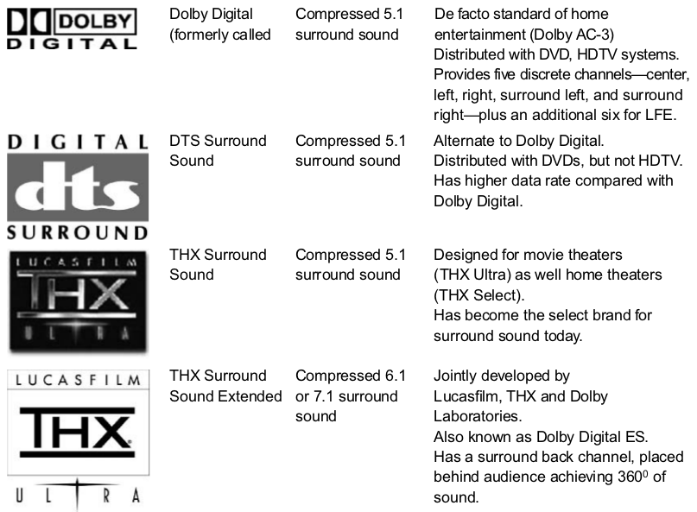
Commonly used audio format(contd ...)
B C Dhara, Dept. of IT, JU

Slide 11
Digital audio and its application
Audio was the first digitally distributed media type, in the form of compact discs (CDs),
  CD audio was uncompressed
A variety of applications, including Apple’s iPod and online music sites, store stereo-quality audio in the popular MP3 format
  result is a variety of industry standards, such as the MPEG MP3, AAC, Dolby AC-3, and DTS
This presentation deals with digital audio compression techniques to obtain compact digital representations for narrow-band (speech) and wide-band (music) audio
B C Dhara, Dept. of IT, JU

Slide 12
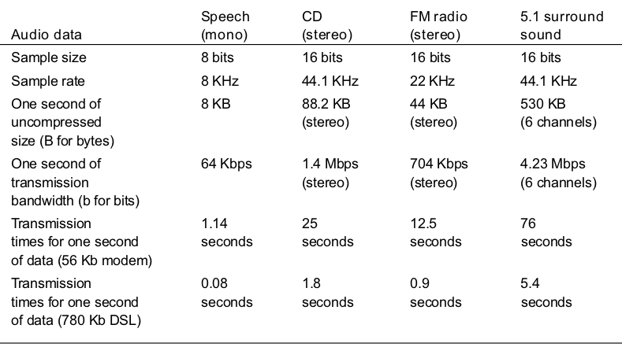
Need for audio compression
Lists the storage and transmission requirements for various kinds of audio signals
Transmitting this uncompressed content for streaming purposes is virtually impossible on the current consumer bandwidths
Various compression techniques and standards have been designed to help make this possible
Size of a CD to store a 70 min audio is: 2*16*44100 =1411200 ≈ 1.41 Megabits
1.41 *70*60 ≈ 735 MB
The amount of data needed to be delivered to the end client per second does not suffice the real-time needs at commonly available modem rates and even at broadband rates for some signals
B C Dhara, Dept. of IT, JU

Slide 13
AUDIO-COMPRESSION THEORY
Digital audio is represented as a one-dimensional set of PCM samples
  Images have spatial 2D representations, and video has 3D spatiotemporal representations
The dimensional simplicity of audio signals might expect audio compression techniques to be less complex
B C Dhara, Dept. of IT, JU

Slide 14
Introduction to audio coding
Visual domain signals (image/video) carry larger amounts of information and more signal redundancy compared with audio signals
HAS (human auditory system) is more sensitive to noise and quality degradation when compared with HVS (human visual system)
  For Audio-compression technique, we need to be careful with any loss and distortion that might be imposed during compression
B C Dhara, Dept. of IT, JU

Slide 15
Introduction to audio coding (contd …)
Digital audio is represented in the form of channels
  The number of channels describes whether the audio signal is mono, stereo, or even surround sound
Each channel consists of a sequence of samples and can be described by a sampling rate and quantization bits
The perceived quality after compression and decompression needs to be maximized, while at the same time the amount of information needed to represent the audio signal needs to be minimized
B C Dhara, Dept. of IT, JU

Slide 16
Introduction to audio coding (contd …)
The factors need to be under consideration are:
  Fidelity—Fidelity describes how perceptually different the output of the codec is when compared with the original signal
    The expected fidelity might vary with applications
    Higher levels of fidelity are expected for distribution of music compare to telephone quality
    Data rates and greater codec complexity
Data rate or bit rate—The data rate is an important factor for compression
  Higher data rates have better audio quality but imply higher costs in transmission and storage
B C Dhara, Dept. of IT, JU

Slide 17
Introduction to audio coding (contd …)
Complexity—The complexity of an audio codec translates into hardware and software costs in the encoder and decoder
The complexity trade-offs depend on the application
  In a non-real-time audio broadcast situation where the encoding is done once
    the encoding complexity can be high—requiring more time but producing good fidelity at a lower bit rate
    Low-cost decoders are preferable compared with the encoder
  In a real-time videoconferencing application, both the encoder and decoder need scaled-down complexities to address real-time issues
B C Dhara, Dept. of IT, JU

Slide 18
Introduction to audio coding (contd …)
Earlier audio compression techniques aim to reduce only the statistical redundancy
Now-a-days techniques borrow more sophisticated theories from psychoacoustics and remove redundancy in digital audio depending on what the HAS can or cannot perceive
Psychoacoustics is a rich area of research in compression of digital audio
B C Dhara, Dept. of IT, JU

Slide 19
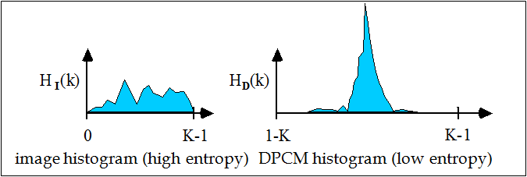
AUDIO AS A WAVEFORM
Compression here can only be achieved by different quantization strategies, followed by the removal of statistical redundancies using entropy coding
Differential pulse code modulation (DPCM) is the most simplistic form of compression
  It exploits the fact that the range of differences in the amplitude between successive audio samples is less than the range of the actual sample amplitudes
  As a result, coding the differences between the successive signal samples reduces the entropy and hence achieve the compression
B C Dhara, Dept. of IT, JU

Slide 20
Statistical audio coding methods
DPCM is is a prediction-based method, where the next sample is predicted as the current sample, and the difference between the predicted and actual sample is coded
The closer the predicted value, the smaller the range of variation in the difference errors
Predicting the next sample value based only on one previous sample may be simple
  but not as effective as involving a number of immediately preceding samples in the prediction process
B C Dhara, Dept. of IT, JU

Slide 21
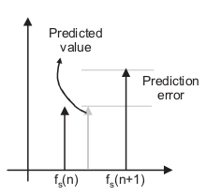
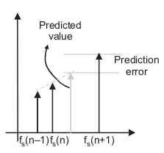
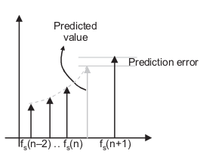
Statistical audio coding methods (contd ...)
Predictive method
The preceding samples are weighted by coefficients that suggest how much a preceding sample influences the current sample value
  These are called predictor coefficients
Prediction based on preceding sample
A linear combination of previous two samples
A weighted combination of previous three samples
B C Dhara, Dept. of IT, JU

Slide 22
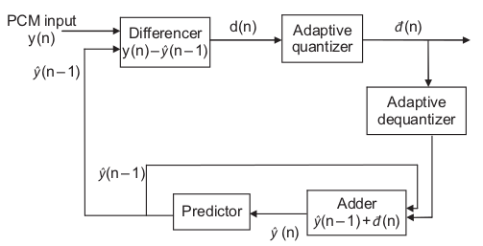
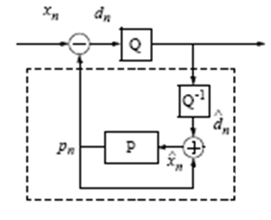
Adaptive differential pulse code modulation (ADPCM)
ADPCM encoders use two modes for adaptive quantization:
one for low frequency and
the other for high frequency
When the frequency content of the input signal is low, d(n) is smaller and fewer bits can be used to quantize the value, and vice versa.
It is same as DPCM, except for the fact that it adaptively modifies the number of bits used to quantize the differences
B C Dhara, Dept. of IT, JU

Slide 23
Logarithmic Quantization Scales:A-law and μ law
In the above methods, the dynamic range of the digitized audio signal is uniformly quantized
Some encoding methods such as A-law and μ-law follow a logarithm quantization scale, also known as companding
  This is non-linear quantization
  It is based on the statistical observation of the intensities
  For example, the intensities of speech are more likely to concentrate at lower intensity levels, rather than at higher intensity levels
B C Dhara, Dept. of IT, JU

Slide 24
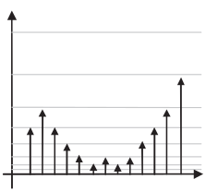
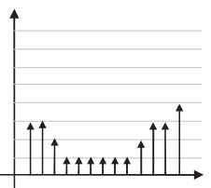
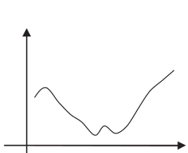
Logarithmic Quantization Scales:A-law and μ law (contd ...)
  Quantizations corresponding to lower amplitudes have smaller error than quantizations corresponding to higher amplitudes
logarithmically quantized interval scale
original analog signal
uniform quantization intervals
B C Dhara, Dept. of IT, JU

Slide 25
Logarithmic Quantization Scales:A-law and μ law (contd ...)
Audio speech signals tend to have a large dynamic range
  Require a large number of quantization levels, typically 4096 levels, which require 13 bits
The human ear is more sensitive to lower amplitude intensities than to larger amplitude values
Better compression results are obtained by minimizing quantization errors at lower amplitudes than at higher amplitudes
B C Dhara, Dept. of IT, JU

Slide 26
Logarithmic Quantization Scales:A-law and μ law (contd ...)
The sampled signal at 13 bits is companded (logarithmically mapped) to 256 nonuniform 8-bit quantization levels
Two particular logarithmic quantization techniques for PCM audio are defined by the ITU:
  The American μ-law standard, which compands 14 bits to 8 bits, and
  The European A-law standard, which compands 13 bits to 8 bits
B C Dhara, Dept. of IT, JU

Slide 27
Audio Compression Using Psychoacoustics model
Compression achieved based on statistical analysis in PCM coding techniques is not sufficient for the data rates required of modern networked applications such as streaming audio
  we discuss a class of compression techniques base on analysis of how the human auditory system works
  Psychoacoustics is the branch of psychology that deals with this study of the way humans perceive sound
B C Dhara, Dept. of IT, JU

Slide 28
Audio Compression Using Psychoacoustics model (contd …)
The human auditory system is capable of perceiving frequencies between 20 Hz and 20 KHz
Prior to compression, appropriate filters can be utilized to ensure that only the “audible frequency content” is input to the encoder
Two events can be uniquely perceived by the ear if the events separated by more than 30 milliseconds
The perception of simultaneous events (apart < 30 milliseconds) is resolved in the frequency domain
B C Dhara, Dept. of IT, JU

Slide 29
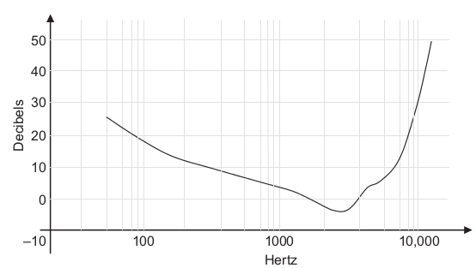
Masking or Hiding
If two sound tones or frequencies are present in the signal, the presence of one might hide the perception of the other, the result being that only one tone is perceived
  The audibility level of one frequency is affected by the presence of another neighborhood frequency
  To understand how frequencies mask each other, let’s consider the curve
B C Dhara, Dept. of IT, JU

Slide 30
Masking or Hiding (contd …)
This curve gives the decibel levels for all frequencies at which the sound at that frequency is just audible
A particular frequency tone is generated so that subject can hear it. It is then reduced to zero and increased until it is just barely audible and the decibel level for that frequency is noted
The ear’s response is not the same for all frequencies and changes nonlinearly
B C Dhara, Dept. of IT, JU

Slide 31
Masking or Hiding (contd …)
If the audio signal has frequency whose energy level is below the threshold curve
  it will not be heard
  if a frequency is not going to be perceived, there is no need to assign any bits to it
  if the input signal has frequency whose amplitude level is above the threshold curve, it must be assigned bits during compression
B C Dhara, Dept. of IT, JU

Slide 32
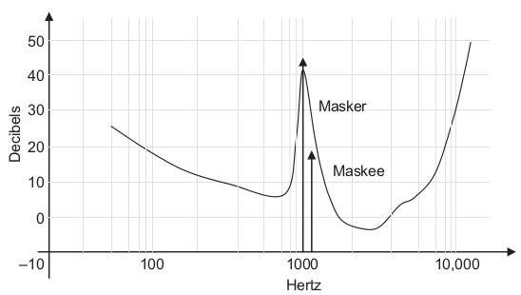
Frequency masking
The presence of a perceptible frequency changes the shape of the threshold curve
1 KHz is known as masker and 1.1 KHz is as the maskee
The 1 KHz tone is masking or hiding the 1.1 KHz neighborhood tone
The presence of a 1 KHz frequency at 45 dB ➔ The neighbouring tone at frequency 1.1KHz at 20 dB audible (but not as a distinct one)
if a frequency is masked and, consequently, not heard, there is no need to encode it
B C Dhara, Dept. of IT, JU

Slide 33
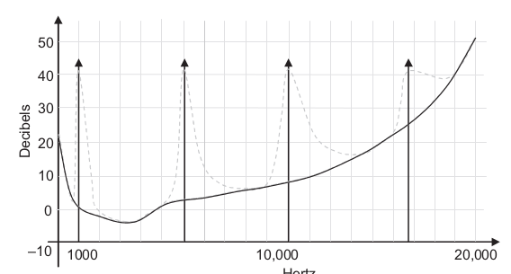
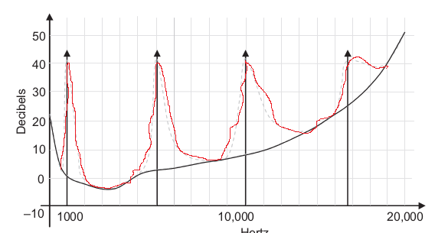
Frequency masking (contd …)
In general, the higher the frequency of the masker, the broader the range of influence it has and more neighbourhood frequencies it masks
As the frequency increases, the masking area also increases, which is a perceptual nonuniformity
B C Dhara, Dept. of IT, JU

Slide 34
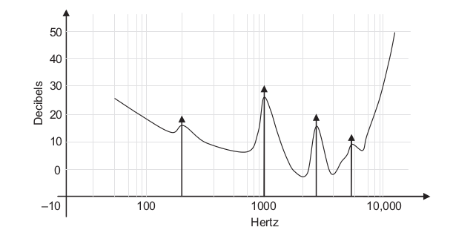
Frequency masking (contd …)
Due to the presence of multiple masking frequencies in different bands the threshold curve changes in a complex and nonuniform manner for different frequencies
  Good perceptual models are needed to accurately model the curve with energies distributed unevenly at every frequency
The presence of multiple maskers, the threshold curve gets raised, masking a lot more frequencies
B C Dhara, Dept. of IT, JU

Slide 35

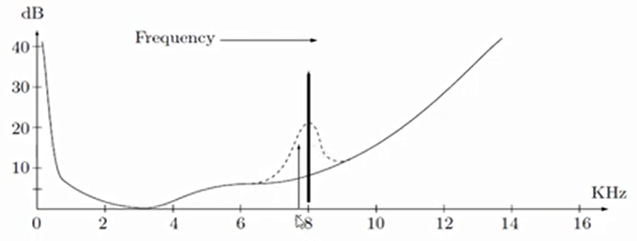
Example of frequency masking: effect
This is called frequency masking
We need not encode the signal x
Increase the threshold on hearing in the vicinity of the sound
Lower sound at x but grater than actual threshold and cannot be heard
B C Dhara, Dept. of IT, JU

Slide 36
Critical bands
The human hearing range divides into critical bands, with the property that the human auditory system cannot distinguish the better sound when two sounds are present
  Hearing has a limited, frequency-dependent resolution
At the low-frequency end, a critical band is less than 100 Hz wide
For high frequencies, the width can be greater than 4 kHz
  This indeed is yet another kind of perceptual nonuniformity.
B C Dhara, Dept. of IT, JU

Slide 37
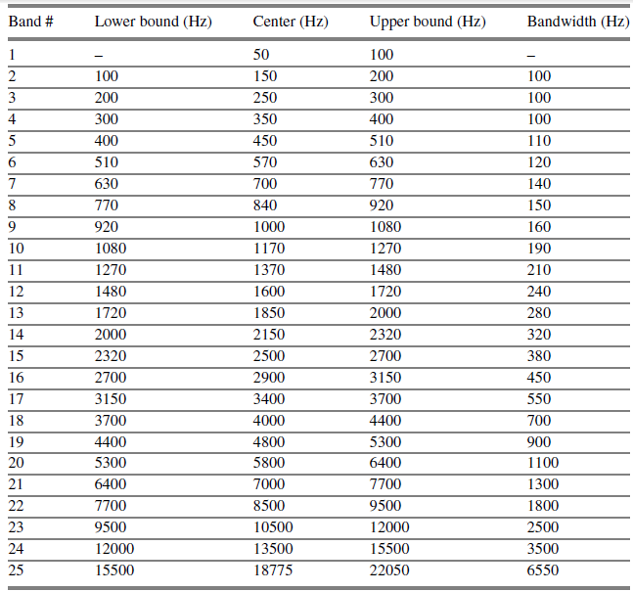
Partition of hearing range
Our hearing apparatus actually is tuned to certain critical bands
B C Dhara, Dept. of IT, JU

Slide 38
Time sensitivity of hearing
After listening (loud) tone, the hearing receptors in the inner ear become saturated, and they require time to recover
For example,
  Suppose a tone is playing at 1 kHz with a volume level of 60 dB, and
  a nearby tone is playing at , say, 1.1 kHz with a volume level of 40 dB
  The second tone will be masked by the first one
  Once the masking tone is turned off, we can again hear the 1.1 kHz tone, but only after a small amount of time
B C Dhara, Dept. of IT, JU

Slide 39
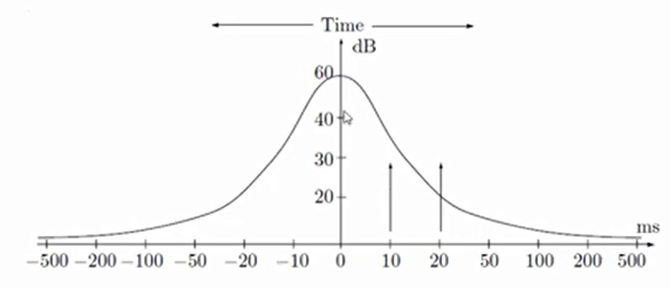
Temporal masking
Listen a sound at time instant 0 ms
  It’s effect is shown in the following figure
For another sound at 20ms
with 30dB can be heard
partially
For another sound at 10ms
with 30dB cannot be heard
B C Dhara, Dept. of IT, JU

Slide 40
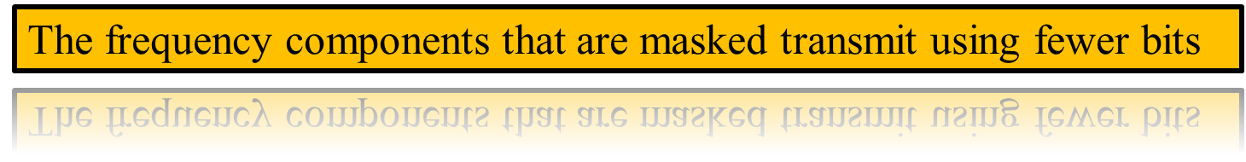
Pre/post masking
Post masking: mask other signals that occur just after the masking sound
Pre masking: a particular signal can even mask sounds played just before the stronger signal
Pre masking has a much shorter effective interval 2–5 ms
Post masking has effect, usually, 50–200 ms
B C Dhara, Dept. of IT, JU

Slide 41
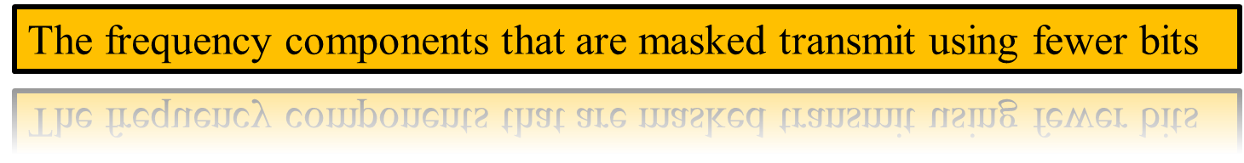
Perceptual coding of audio
A main technique used in evaluating audio content for possible compression makes use of a psychoacoustic model of hearing
The kind of such coding is referred to as perceptual coding
Range of human hearing is about 20 Hz to about 20 kHz
Sounds at higher frequencies are ultrasonic
Frequency range of the voice is typically only from about 500 Hz to 4 kHz
B C Dhara, Dept. of IT, JU

Slide 42
Lossy sound compression
It is possible to achieve better sound lossy compression, we adopt the concept of the frequency masking and temporal masking
  Discard data to which the human ear is not sensitive
B C Dhara, Dept. of IT, JU

Slide 43
Lossy sound compression: companding
More precise samples at low amplitude and less precise samples at higher amplitude
  Lower amplitude ➔ fine quantization
  Higher amplitude ➔ coarse quantization
Companding is non-linear
B C Dhara, Dept. of IT, JU

Slide 44
AUDIO CODING STANDARDS
There are many international and commercial audio coding standards
  The ISO/MPEG family, the ITU family, and standalone proprietary standards such as Dolby AC-3
B C Dhara, Dept. of IT, JU

Slide 45
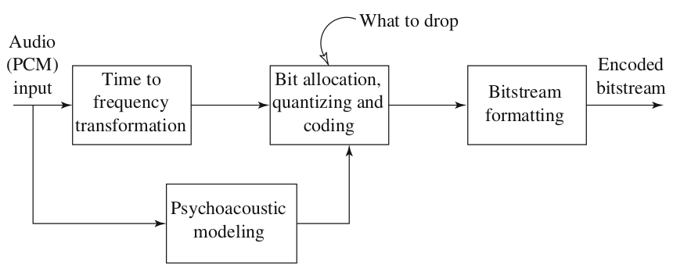
MPEG audio compression
Basic MPEG audio encoder
The input signal is divided into 32 frequency sub-bands via a filter bank
B C Dhara, Dept. of IT, JU

Slide 46
MPEG audio Encoder
The input signal is transformed to the frequency domain and the frequency coefficients are quantized
  the perceptual distortion that occurs due to quantization has to be minimized (the more perceptually dominant frequencies get more bits)
In image and video coding, low frequencies are generally considered dominant
  a constant quantization table suffices during the encoding process
The quantization step in image coding is reduced to a simple lookup to find out how many bits a frequency coefficient has
B C Dhara, Dept. of IT, JU

Slide 47
MPEG audio Encoder (contd …)
In audio, there is no universal frequency or frequency range that perceptually dominates
  Frequencies that dominate at one instant in time might be masked at another instant of time, depending on what tones are heard
The quantization table used to allocate bits to frequency coefficients, constantly changes dynamically
  This makes an audio encoder process more complex because it has to constantly model the audio threshold curve, selecting the important as well as imperceptible frequencies on the fly
B C Dhara, Dept. of IT, JU

Slide 48
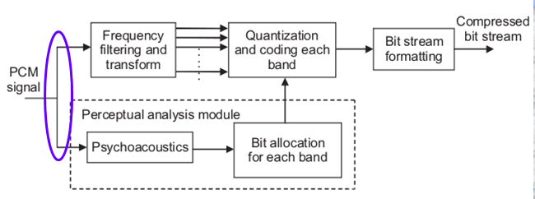
MPEG audio Encoder (contd …)
The input signal is divided into windows of samples
  Each window contains samples that are normally multiples of two between 512 and 4096
  All the windows can be thought of as independent signals
The data window then follows two parallel paths
  it undergoes subband filtering and then split into different frequencies and the coefficients are quantized
  the input signal goes through a perceptual analysis module, which attempts to model the threshold curve using the psychoacoustic principles
    The perceptual model analyzes the importance of frequency bands, and a bit allocation strategy is conveyed to the encoder
B C Dhara, Dept. of IT, JU

Slide 49
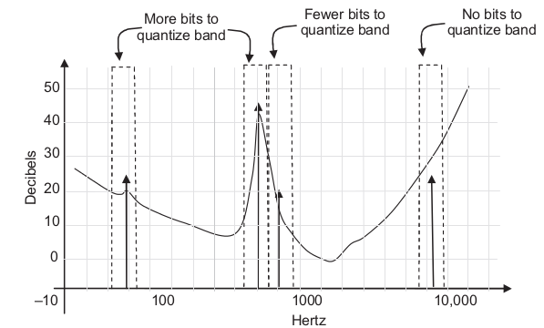
MPEG audio Encoder (contd …)
The encoder then quantizes the frequency coefficients depending on the bit allocation strategy conveyed to it by the perceptual analysis process
Important and definitely perceptible bands are given more bits than the bands that get completely masked
B C Dhara, Dept. of IT, JU

Slide 50
MPEG-1audio coding
The MPEG-1 audio-coding standard consists of three layers of audio-coding schemes
  MPEG-1 Layer I,
  MPEG-1 Layer II, and
  MPEG-1 Layer III (also known as MP3)
  The layers are backward compatible,
  A compressed Layer 1 bit stream can be decoded by a Layer 2/Layer 3 decoder
  A Layer 2 compressed bit stream can be decoded by a Layer 3 decoder
increasing complexity,
successively better compression
The objective of MPEG layers: a good tradeoff between quality and bit-rate
B C Dhara, Dept. of IT, JU

Slide 51
MPEG layers (contd …)
Layer 1: quality of the audio can be quite good provided a comparatively high bit-rate is available
  Digital audio tape typically uses layer 1 at around 192 kbps
Layer 2: has more complexity proposed for use in digital audio broadcasting
Layer 3: is most complex, originally aimed for audio transmission over ISDN lines
Complexity increases at encoder, not at decoder
  In audio application, we need faster decoding ➔ MP3 is most popular
B C Dhara, Dept. of IT, JU

Slide 52
Features of MPEG-1 layers
Layer 1:
  the psychoacoustic model uses only frequency masking
  Bitrates: 32 kbps (mono) to 448 kbps (stereo), Near-CD stereo 256-384 kbps
Layer 2:
  Temporal masking by accumulating more samples and examining temporal masking between the current block of samples and ones just before and just after
  Bitrates: 32 – 192 kbps (mono)
  64-384 kbps (stereo) and CD-audio 192- 256 kbps
B C Dhara, Dept. of IT, JU

Slide 53
Features of MPEG-1 layers (contd …)
Layer 3: lower bit rate applications; more sophisticated subband analysis, non-uniform subband widths, non-uniform quantization and entropy coding
  Bitrates: 32 – 320 kbps
B C Dhara, Dept. of IT, JU

Slide 54
Salient features for Layer I
The encoding quality is transparent at 384 Kbps
  The compressed audio is not differentiable from the original
Subband coding is employed by dividing the frequencies into 32 bands (12 samples/band), and each band quantized differently
Coefficients are normalized to extract the scale factor
For each block of 32 bands, the psychoacoustic model provides one of 16 quantizers
MPEG-1 operates in one of four possible modes:
  mono, stereo, dual channel, and joint stereo
B C Dhara, Dept. of IT, JU

Slide 55
Salient features for Layer II
Layer II introduces further compression to Layer I
  The 1024-point FFT (compared with 512 in Layer I) provides an improved precision for the psychoacoustic process
    Allowing a better bit allocation strategy
  The scale factor processing is different, removing more redundancy in the scale factor data
  The encoding quality is transparent at 296 Kbps
  Layer II also employs subband coding using 32 channels
  The quantizer has finer resolution compared with Layer I
    This is because of the 1024-point FFT
B C Dhara, Dept. of IT, JU

Slide 56
Basic algorithm
if sampling proceeds at 32 kbps, then a time duration of 12 ms is required since each set of 32 samples is transmitted each millisecond
Dividing the input signal into 32 frequency subbands, via a filter bank
  A liner operation, input is 32 samples (in time domain) and output is 32 frequency coefficients
Layer 1: the sets of 32 PCM values are first assembled into a set of 12 groups of 32 samples (which define the frame)
  A time lag = time to accumulate 384 (12 x 32 ) samples
Layer 2 & 3: frame accumulates more than 12 samples in each subband: a frame includes 1152 samples
B C Dhara, Dept. of IT, JU

Slide 57


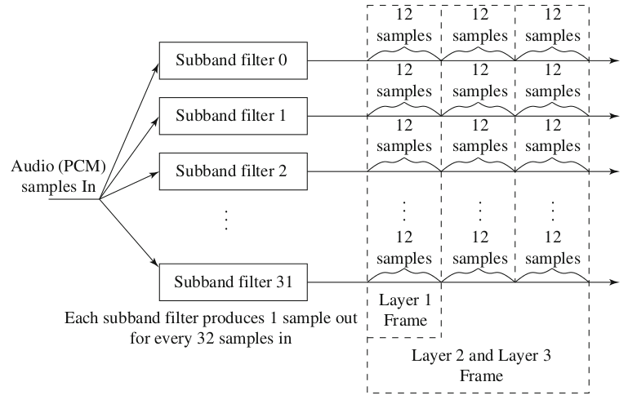
MPEG audio frame sizes
B C Dhara, Dept. of IT, JU

Slide 58
Basic algorithm (contd …)
The point of assembling the segment is to examine 12 values at once, in each of the 32 subbands
  Do the frequency analysis, and then base quantizations are figure out
The delay not just depends on the gathering of the 384 samples. Also delay for
  header information,
  Ancillary data: multilingual data and surround-sound data
B C Dhara, Dept. of IT, JU

Slide 59

MPEG audio frame
Higher layers also allow more than 384 samples to be analyzed, so the format of the subband-samples (SBS) is also needed
The header contains a synchronization code (twelve 1s—111111111111), the sampling rate used, the bitrate, and stereo information
MPEG audio frame
MPEG-1 decoder can partially decode MPEG-2 as header part is same
and additional information of MPEG-2 is stored in ancillary part
B C Dhara, Dept. of IT, JU

Slide 60
MPEG audio frame (contd …)
MPEG Audio is set up to be able to handle stereo or mono channels, of course
A 32×12 segment is considered as a 32×12 matrix
  The next stage of the algorithm is concerned with scale, so that proper quantization levels can be set
  For each of the 32 subbands, the maximum amplitude of the 12 samples in that row of the array is found, which is the scaling factor for that subband
  This maximum is then passed to the bit allocation block of the algorithm, along with the SBS (subband samples)
B C Dhara, Dept. of IT, JU

Slide 61
MPEG audio frame (contd …)
The key point of the bit allocation block is
  to determine how to apportion (divide and allocate) the total number of code bits available for the quantization of subband signals
  to minimize the audibility of the quantization noise
A decision step is included to decide whether each frequency band is basically like a tone or like noise
  From that decision and the scaling factor, a masking threshold is calculated for each band and compared with the threshold of hearing.
B C Dhara, Dept. of IT, JU

Slide 62

The bit allocation algorithm (for Layer 1 and Layer 2)
This determines the quantization (the minimum number of bits that is needed) , if avilable
The amount of a signal above the threshold (SMR) is the amount that needs to be coded
Signals that are below the threshold do not
Aim: all the quantization noise is below the masking threshold
The psychoacoustic model is used to allocate more bits to the subbands which is more beneficial in terms of quality
The psychoacoustic model, calculate the Signal-to-Mask Ratio (SMR) in decibels (dBs) for each subband
B C Dhara, Dept. of IT, JU

Slide 63
The bit allocation algorithm (for Layer 1 and Layer 2) (contd ...)
For each band the psychoacoustic model calculates:
  Signal-to-Noise Ratio (SNR)
    A lookup table provides an estimate of SNR assuming a given number of quantizer levels
  Mask-to-Noise Ratio (MNR) , MNR_{dB} ≡ SNR_{dB} - SMR_{dB}
  The MNR is used to determine the code-bits and accordingly bits are allocated
Iterate until no bits left to allocate:
  Allocate bits to the subband with the lowest MNR
  Compute new estimate of SNR for the subband allocated more bits, and recalculate MNR
B C Dhara, Dept. of IT, JU

Slide 64
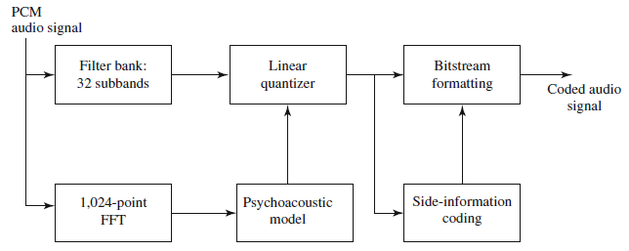
Mask calculation in MEPG layer 1 & 2
In Layer 1,
16 uniform quantizers are precalculated
for each subband the quantizer giving the lowest distortion is chosen
for each subband, a 4 bit index is sent as side information
The maximum resolution of each quantizer is 15 bits
512-point FFT
The masking curve calculation requires an accurate frequency decomposition of the input signal
  using a Discrete Fourier Transform (DFT), the frequency spectrum is usually calculated with a 512/1,024-point Fast Fourier Transform (FFT)
B C Dhara, Dept. of IT, JU

Slide 65
MPEG layer 2
Layer 2 of the MPEG-1 Audio codec includes small changes to effect bitrate reduction and quality improvement
  at the price of an increase in complexity
In Layer 2,
  three groups of 12 samples (36 samples) are encoded in each frame
  frequency masking + temporal masking (additional)
  Advantage: if the scaling factor is similar for each of the three groups, a single scaling factor can be used for all three.
B C Dhara, Dept. of IT, JU

Slide 66
MPEG layer 2 (contd …)
  The psychoacoustic model does better as comparatively slower
Bit allocation is applied to window lengths of 36 samples instead of 12
Resolution of the quantizers is increased from 15 bits to 16
B C Dhara, Dept. of IT, JU

Slide 67
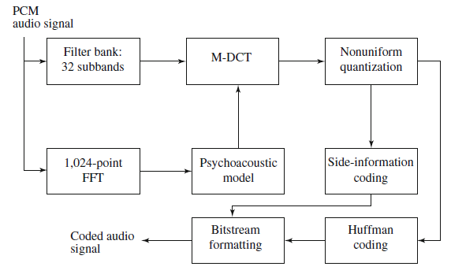
MPEG layer 3 audio coding (MP3)
Layer 3, or MP3, uses a bitrate similar to Layers 1 and 2
  Produces substantially better audio quality
  At the price of increased complexity
a refinement of the Fourier transform, reduce block edge effect
the window is 50% overlapped
Bits are saved
B C Dhara, Dept. of IT, JU

Slide 68
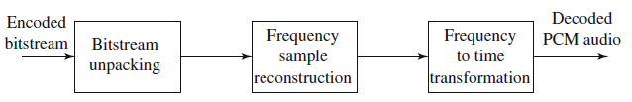
Decoder of MPEG audio compression
The decoder side, the values are de-quantized, and magnitudes of the 32 samples are re-established
These are passed to a bank of synthesis filters, which reconstitute a set of 32 PCM samples
Note that the psychoacoustic model is not needed in the decoder
MPEG audio decoder
B C Dhara, Dept. of IT, JU

Slide 69
dump
B C Dhara, Dept. of IT, JU

Slide 70
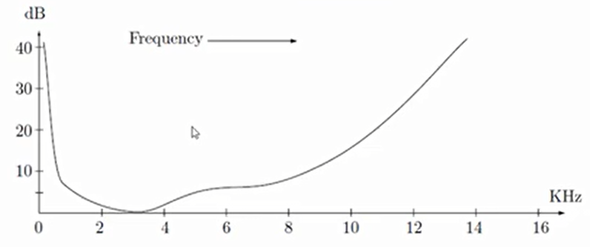
Hearing threshold
Hearing threshold for quiet environment
2KHz – 4 KHz is very sensitive:
Intensity of the sound above the threshold, we can hear
Below, we cannot ➔ will not be included in the encoding (i.e., 0 bit)
B C Dhara, Dept. of IT, JU

Slide 71
Equal-Loudness Relations
We play two pure tones, sinusoidal sound waves, with the same amplitude but different frequencies
  one may sound louder than the other
  The ear does not hear low or high frequencies as well as it does frequencies in the middle range
  At normal sound volume levels, the ear is most sensitive to frequencies between 1 and 5 kHz
B C Dhara, Dept. of IT, JU

Slide 72
Masking (different situations)
A lower tone can effectively mask a higher tone
  The reverse is not true. A higher tone does not mask a lower tone well
  Tones can in fact mask lower frequency sounds, but not as effectively as they mask higher frequency ones
The greater the power in the masking tone, the wider its influence—the broader the range of frequencies it can mask
  As a consequence, if two tones are widely separated in frequency, little masking occurs
B C Dhara, Dept. of IT, JU

Slide 73
Temporal masking
Masking effects are also seen in the time domain and are known as temporal masking.
When a 1 KHz and 1.1 KHz tone are simultaneously present at 45 dB and 20 dB respectively,
  the 1 KHz tone masks the 1.1 KHz tone and, hence, the higher tone cannot be heard
  If the 45 dB masking tone is removed and only the maskee 20 dB tone is present,
    the ear should perceive it because it is above the threshold curve in quiet
  the 20 dB tone is not heard instantly but after only a finite small amount of time
  The amount of time is dependent on the intensity difference between the masker and the maskee
B C Dhara, Dept. of IT, JU

Slide 74
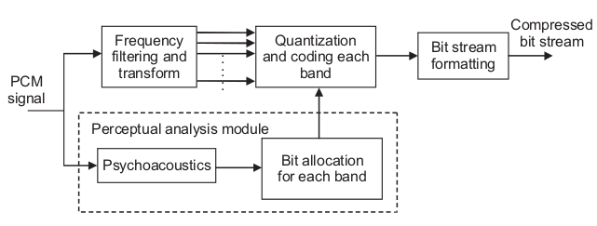
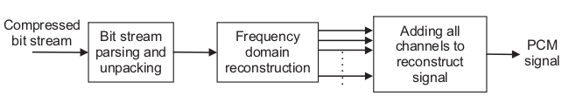
Perceptual encoder/decoder of audio
B C Dhara, Dept. of IT, JU

Slide 75
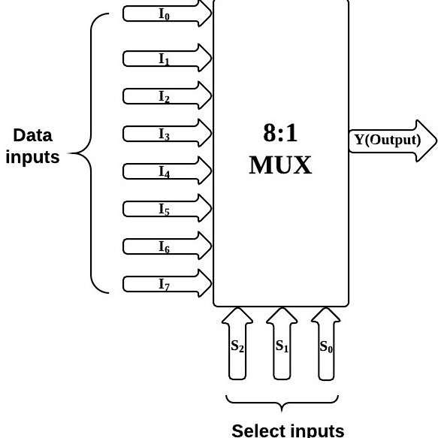
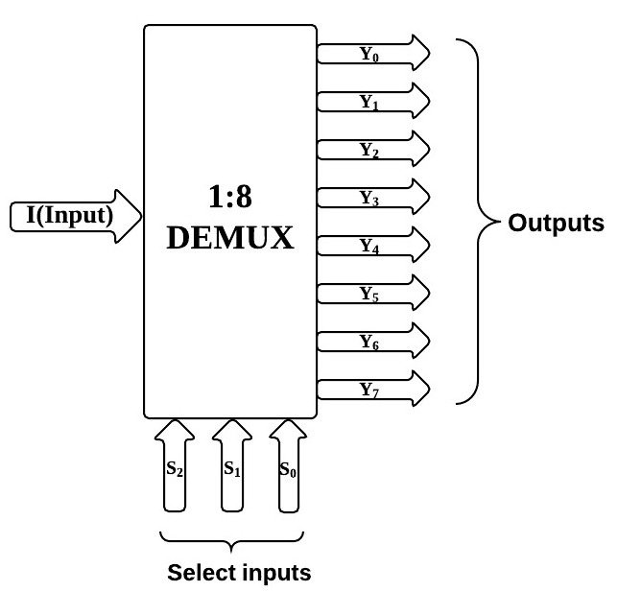
Multiplexer and Demultiplexer
B C Dhara, Dept. of IT, JU

Slide 76
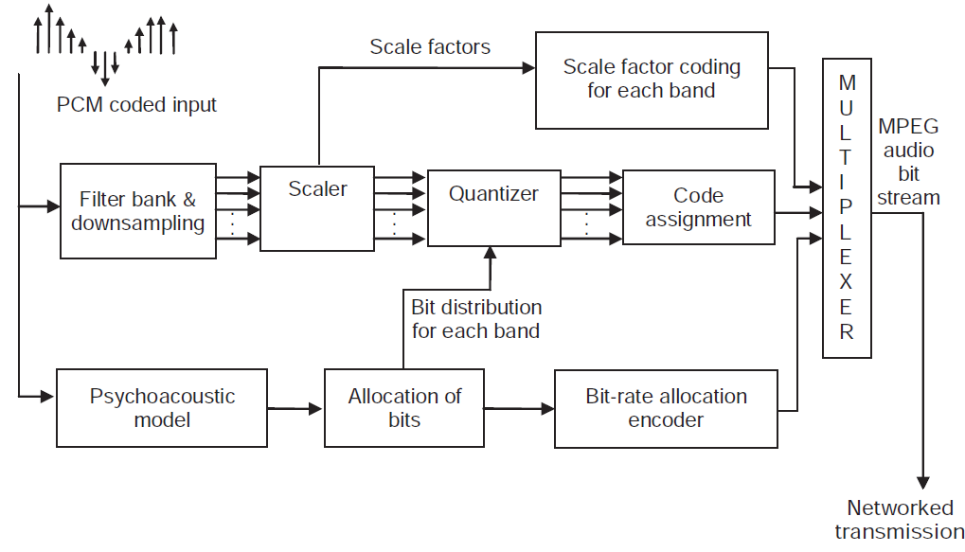
B C Dhara, Dept. of IT, JU

Slide 77
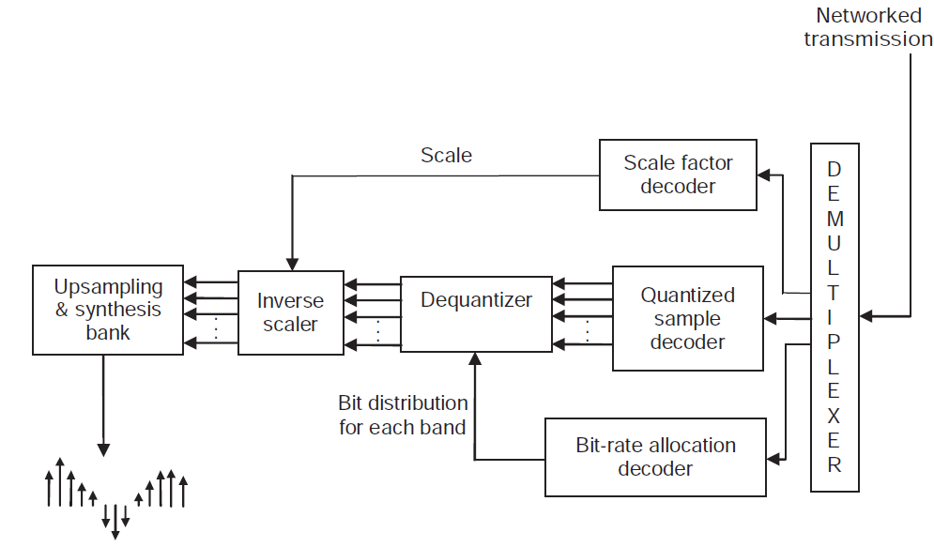
B C Dhara, Dept. of IT, JU

Slide 78
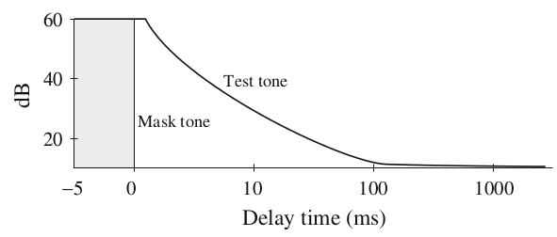
Temporal masking
The louder the test tone, the shorter the amount of time required before the test tone is audible once the masking tone is removed
B C Dhara, Dept. of IT, JU

Slide 79
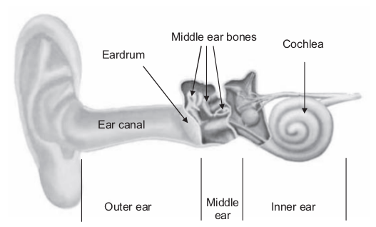
Anatomy of the Ear
Sound enters the ear and travels through the ear canal
  The eardrum receives the sound pulses and conveys the pressure changes via middle ear bones and cochlea to auditory nerve endings
It is important to note that the flow of information via air and fluids is mostly unidirectional
  Hence, most of the models in psychoacoustics, whether simple or sophisticated, pose their analysis as a single dimensional effect
B C Dhara, Dept. of IT, JU

